Slide 1
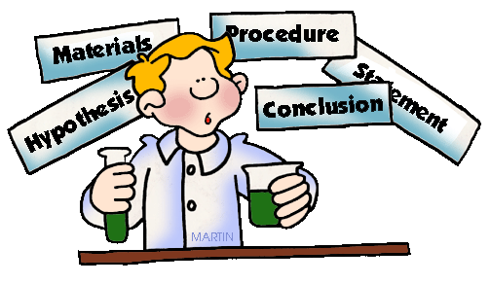
Summative Assessment!
You will plan a science investigation which shows water going through a change.
You will carry out the investigation and then write a conclusion.
During the conclusion, you will reflect upon your investigations and also discuss how your investigation demonstrates that water is essential to life. You will have a rubric and a checklist to help you understand what to do.

Slide 2
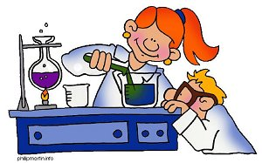
Today…
We will begin creating questions and think about different aspects of water change that you could investigate.
Think about the investigations we have completed so far which show change in some way. You could do a similar one…but not the exact same!
First, we will work in groups to generate questions.
Then we could use the internet to search for possible inquiries.
Finally, you will have independent time to think about your investigations. It is important that you choose something that you want to know the answer to….something that interests you!
By the end of the lesson….You will have a focus area and a few possible focus questions for your inquiry.

Slide 3
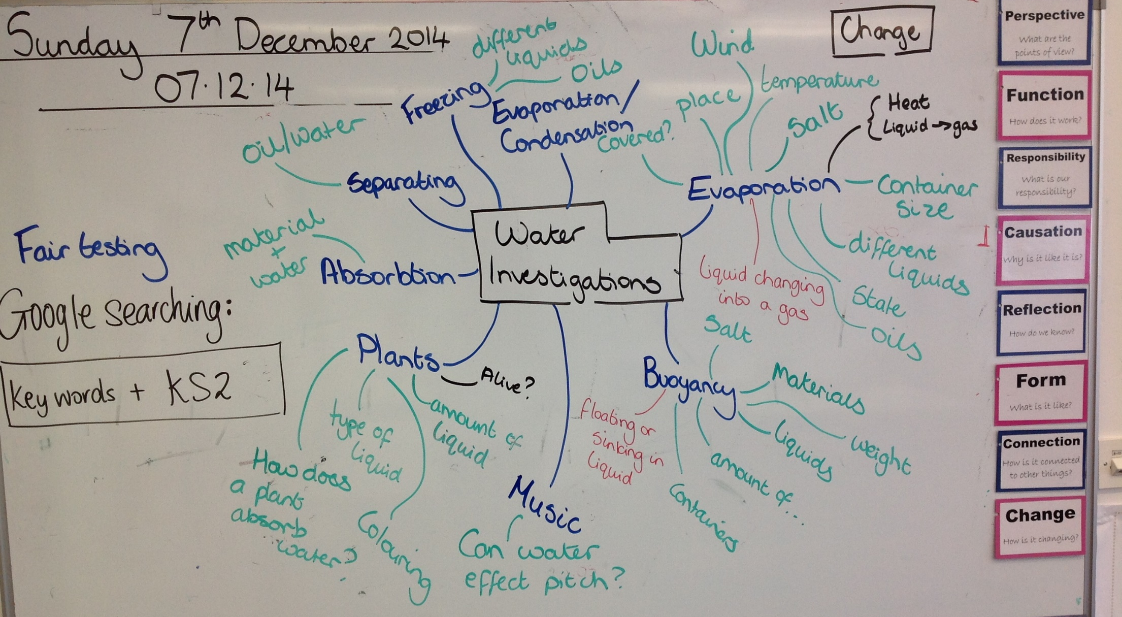
G4B Planning board

Slide 4
A checklist to carry out a scientific inquiry
A scientific question or aim.
Fair testing: Explained the one thing that will change (independent variable) and the things which will stay the same (controlled variables)
List of resources or equipment.
Write a method explaining how to carry out your inquiry.
Write a hypothesis or prediction.
Thought about how to carry out the investigation safely.
A results chart is drawn to gather information.
An explanation is given about the results (what happened)
A conclusion is given (why did it happen).
Reflection on myself as an inquirer.

Slide 5
G4 Summative Assessment Rubric.
 | Developing Scientist | Successful Scientist | Expert Scientist
Question/ Aim | Closed question No scientific vocabulary A loose link to our unit ‘water’ Not standard English language Variables not explained Answer already known | Open-ended Clear and scientific language Focused on our unit ‘water’ Explains variables Something that you don’t already know. | Open-ended Precise and scientific language Focused on our unit ‘water’ Explains variables Something that you don’t already know.
Planning the scientific process | No prediction List of resources or equipment Method – Steps not clear or missing Variables not considered Results chart drawn but missing labels or disorganised. | Prediction List of resources or equipment Method – Sequence of steps Explanation of a fair test – variables considered Results chart drawn Clear and focused language | Prediction with good reasoning why List of resources or equipment Method – Sequence of steps - diagrams Explanation of a fair test – variables clearly considered Clear results chart drawn Clear and focused language
Investigating | Most resources were correct. Results recorded in chart as investigation was carried out. Investigation process was not organized and messy. Showed some collaboration skills – shared of roles and responsibilities Some details of the plan was followed | Correct resources which prepared. Results recorded in chart as investigation was carried out. Carried out the investigation in an organized way Worked safely Good collaboration skills – share of roles and responsibilities Plan was followed | Use of correct resources - prepared and organized independently. Accurate measuring and recording in results chart Organized/ systematic investigation Worked safely. Good collaboration skills – share of roles and responsibilities Plan was followed – changes were reflected upon.
Recording and explanation of results | Some recording of results Measurements and observations recorded in a graph however organization is not clear. Short and simple explanation of what happened Results refer to the questions but do not fully answer it. No reflected made towards the prediction. | Accurate recording of results Measurements and observations recorded in a graph. Explanation of what happened with some extra details. Results answer the question Prediction is referred to and reflected upon. | Accurate recording of results Measurements and observations recorded clearly in a graph. Explanation of what happened with extra details (quickest, slowest, densest). Results answer the question. Prediction is referred to and reflected upon, considering reasons prediction was/not correct. Diagrams showing what happened with labelling.
Conclusion | Some attempts to explain what was discovered. Some scientific language used. | Explain what you discovered…..Now I know…. Use of scientific language to explain why | Explain what you discovered…..Now I know…. Use of scientific language to explain why Connect findings to everyday life and the wider world. Applying and application findings to the world around you.
Personal reflection | Short comments about what worked well in the investigation. Some comments about improvements for next time. Some attempts to reflect upon themselves as a scientist. | Explanation of what worked well in the investigation Explanation of personal scientific inquiry skills. Explanation of what could be improved next time | Explanation of problems and possible solutions for the future. Explanation of what worked well in the investigation Explanation of personal scientific inquiry skills. Shows understanding of ‘what is a good inquirer?’

Slide 6
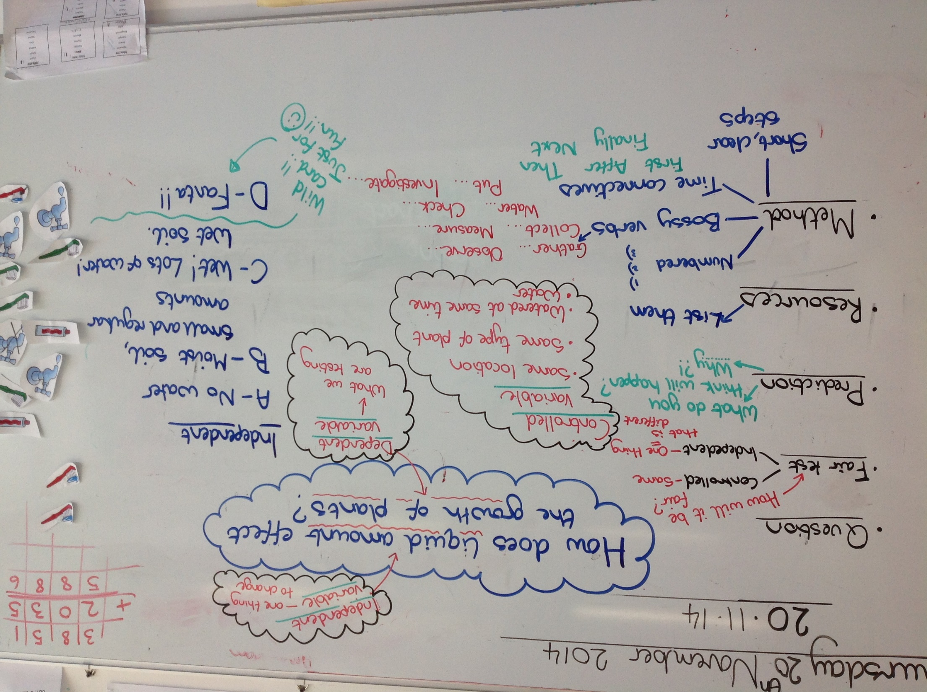
G4B Planning board for previous investigation

